Slide 1

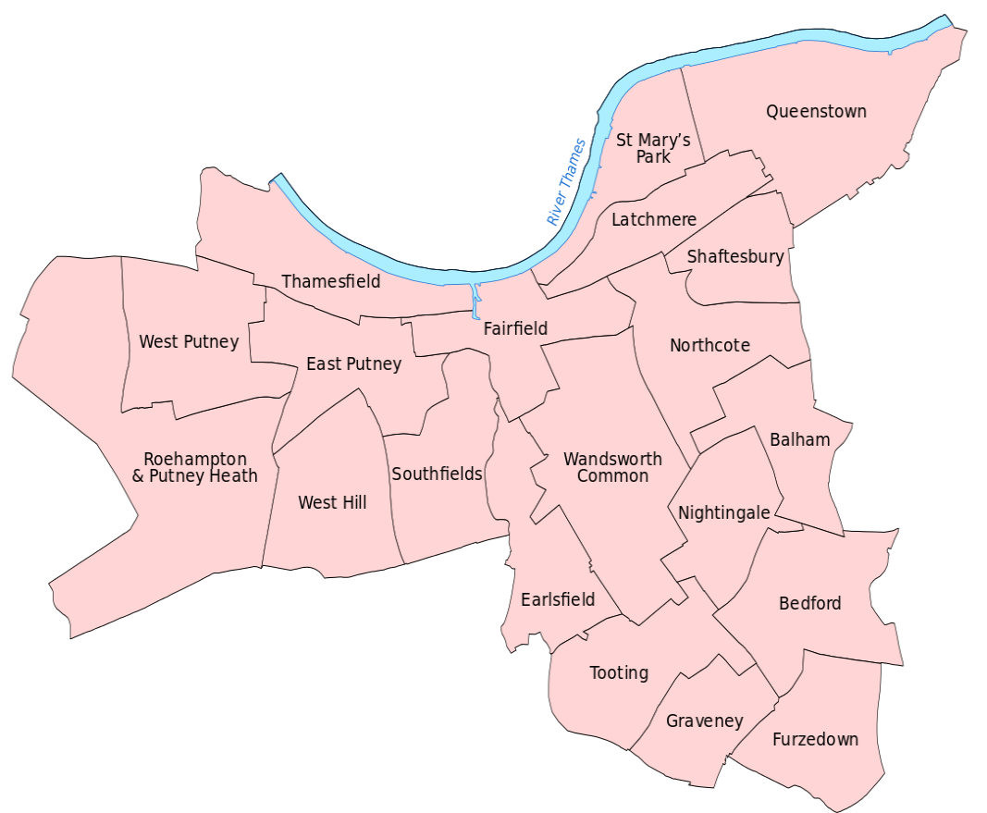
Analysis of Deaths Data in Wandsworth (2016)
Understanding Mortality Patterns in Wandsworth from Registered Deaths and Population Estimates
Notes:
Good morning/afternoon, everyone. Today, I'm here to take you through a revealing journey into the mortality patterns of Wandsworth in 2016. This analysis isn't just about numbers; it's a story of how health, environment, and demographics intertwine within our community.

Slide 2
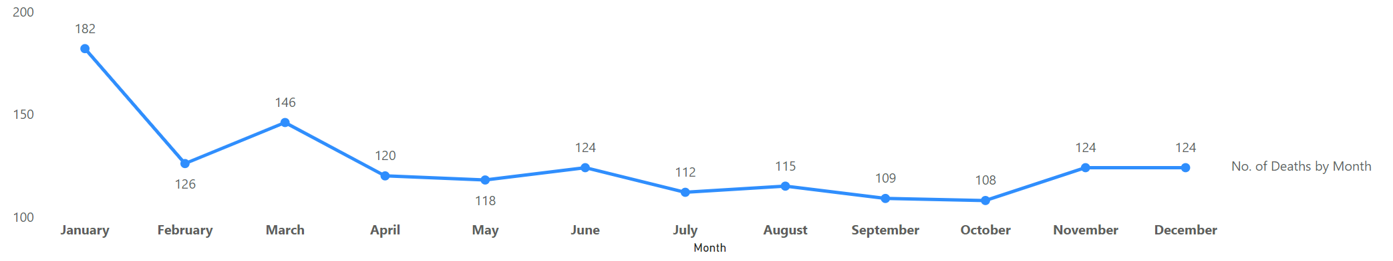
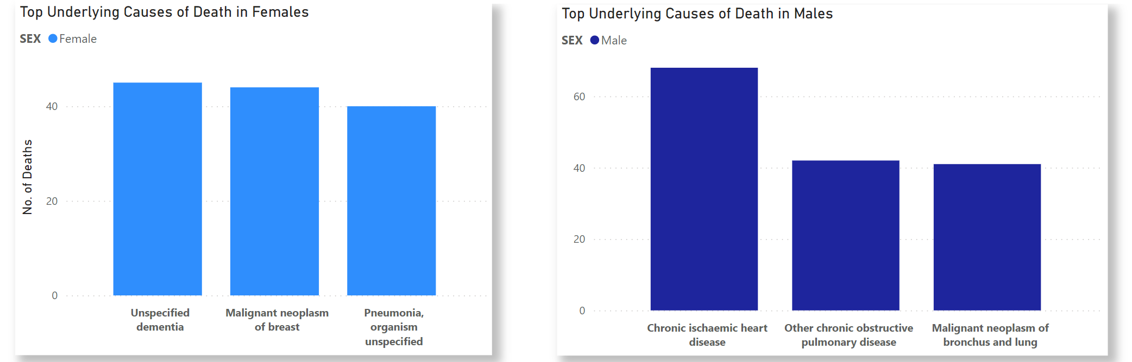


Monthly Distribution and Leading Causes of Death
January recorded the highest number of deaths (182)
Leading cause of Death for Female: Unspecified Dementia Leading cause of Death for Male: Chronic Ischaemic Heart Disease
Notes:
Let's begin with the monthly distribution of deaths. Notice the peak in January - 182 deaths. What makes January so significant? Is it the cold weather, post-holiday stress, or something else? Now, turning to the leading causes of death, we see a stark gender divide. For females, the leading cause is unspecified dementia, and for males, it's chronic ischemic heart disease. This slide underscores the importance of gender-specific healthcare strategies.

Slide 3
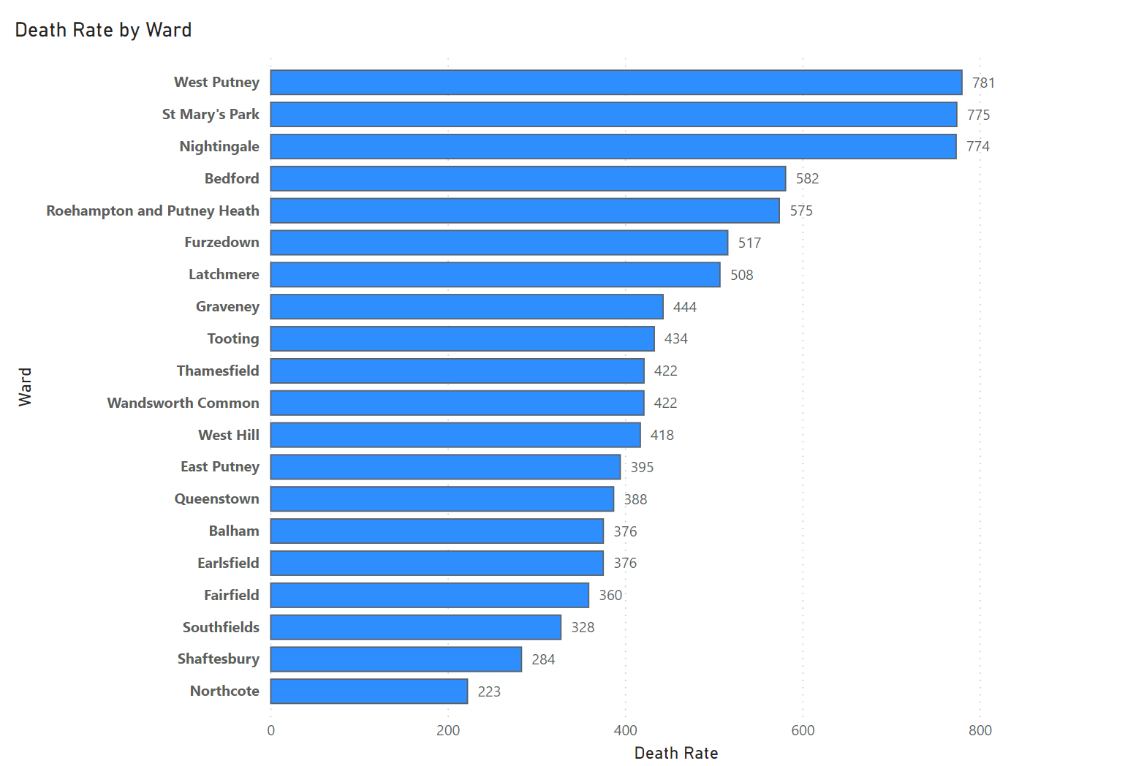
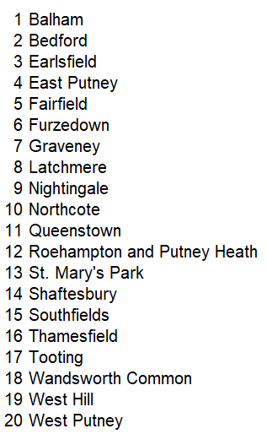
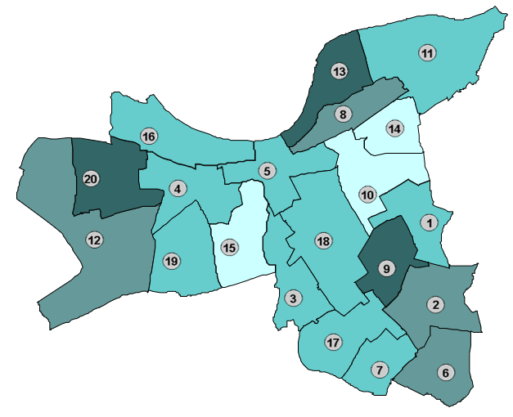
Death Rate per 100,000 Population by Ward
West Putney has the highest death rate (781)
Notes:
This slide presents a geographical perspective. In West Putney, the death rate stands at 781 per 100,000 population, the highest in Wandsworth. What factors contribute to this? Could it be environmental, socio-economic, or healthcare access? Understanding these disparities is crucial for targeted health interventions.

Slide 4

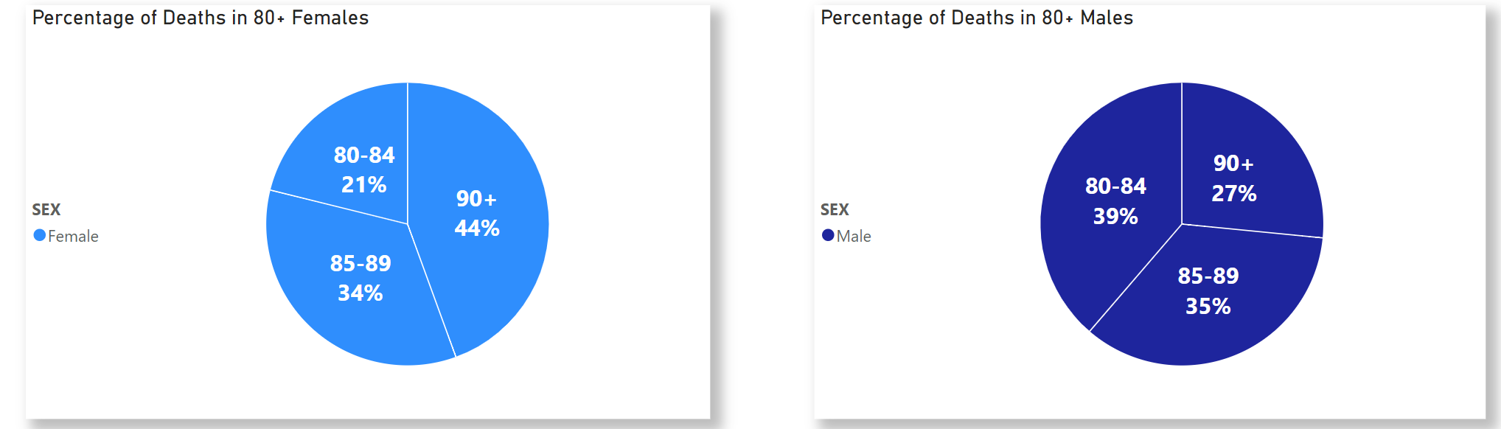
Age Distribution of Deaths (80+ age groups)
Females have a greater share of deaths in the 90+ age group, while males are more evenly spread across (80-84) and (85-89) age brackets.
Notes:
Now, let's delve into the age distribution of deaths. Particularly in the 80+ age groups, we observe more females in the 90+ bracket, while male deaths are more evenly spread across 80-89 years. This indicates not just a longevity gap between genders but also hints at different healthcare needs and challenges in our elderly population

Slide 5




Conclusions
Seasonal Variation
January had the highest mortality, suggesting a need to investigate seasonal health impacts.
Gender-Specific Health concerns
Females predominantly died from unspecified dementia, and males from chronic ischaemic heart disease, highlighting the necessity for targeted health interventions.
Geographical Health Disparities
West Putney's significantly higher death rate indicates potential socio-economic or environmental health influences that require focused attention.
Age and Gender Distribution
A higher proportion of females in the 90+ age group, compared to males more spread between 80-89 years, points towards differing longevity patterns and healthcare needs between genders.
Notes:
To conclude, our analysis reveals critical insights. The high mortality in January suggests a deeper look into seasonal health impacts is needed. The differing causes of death between genders highlight the need for more focused healthcare strategies. The high death rate in West Putney raises questions about local health disparities. Lastly, the age and gender distribution of deaths point towards a need for varied healthcare approaches for our aging population. These findings are not just statistics; they are a call to action for better, more tailored healthcare solutions in Wandsworth.

